Slide 1

Electromagnetic Shielding
F. Rachidi
École Polytechnique Fédérale de Lausanne
EMC Laboratory
Farhad.Rachidi@epfl.ch
http://emc.epfl.ch

Slide 2
Purposes of Shielding
The term shield usually refers to a metallic enclosure that completely encloses an electronic product or a portion of that product.
There are two purposes of a shield:
1. To prevent the emissions of the EM emissions of the electronics of the product from radiating outside the boundaries of the product.

Slide 3
Purposes of Shielding
2. To prevent radiated emissions external to the product from coupling to the product’s electronics.

Slide 4
A Simple Shield
Consider a simple conducting loop in a low-frequency B-field
  The time-varying B-field induces a “back EMF” which induces a current and creates an opposing B-field, B_{s}
  The total B-field B_{tot} = B_{o} + B_{s} is reduced
Thus, this loop appears as sort of a “shield”
I
B_{s}

Slide 5
B-Field in a Conducting Loop
For a loop of radius a, the induced
EMF is given from Lenz’ law as
The induced current in the loop at low frequencies is
  where L_{loop} is the inductance of the loop
I
B_{s}

Slide 6
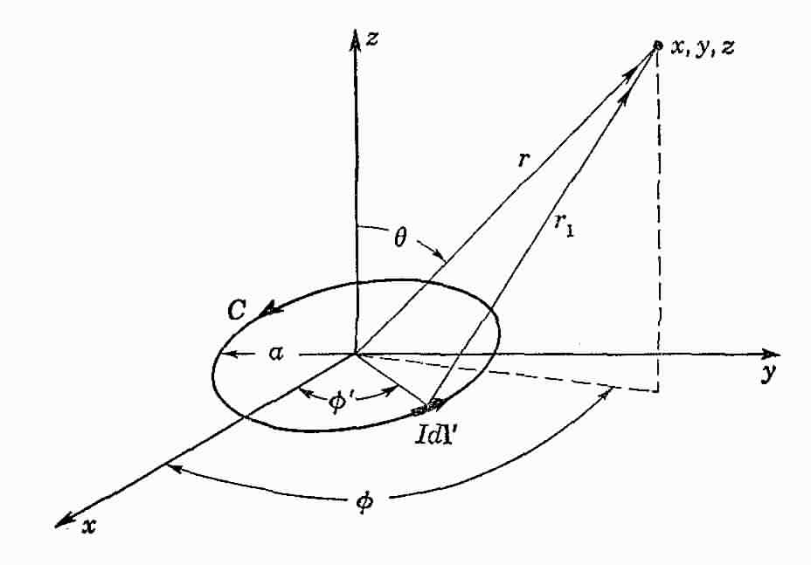
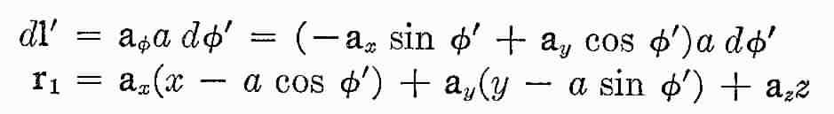
B-Field in a Conducting Loop (Cont’d)
Thus, the loop current I is given as
The B-field at an arbitrary point (x, y, x) due to the loop current can be calculated as
where the following are used

Slide 7
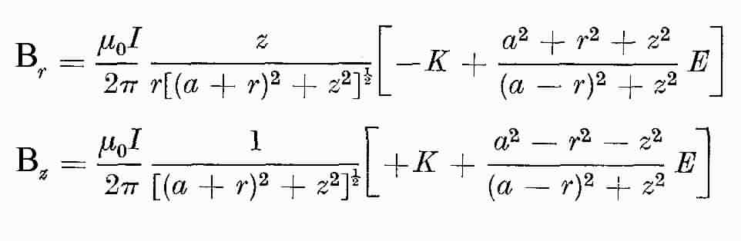
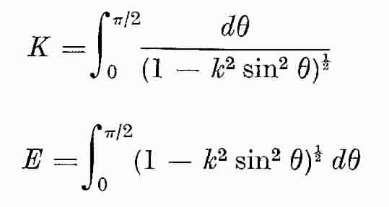

B-Field in a Conducting Loop (Cont’d)
Far from the loop current (r >> a),
the scattered B-field is
Anywhere on the z-axis, the B-field is
The general expression for the scattered B-field everywhere is given by Van Bladel as
K and E are the complete elliptical integrals

Slide 8
B-Field in a Conducting Loop (Cont’d)
Plot of the total B_{z} field
component as a function of the
radial position, r
Note the slight attenuation of the incident field inside the loop
Incident B-field
Loop interior

Slide 9
B-Field in a Conducting Loop (Cont’d)
Define the magnetic field
shielding factor of the
loop as
Plot of shielding factor is

Slide 10
Comments
A single loop is not a very good shield
  But nevertheless, it does attenuate the field slightly
We can think of adding more loops surrounding the shielded volume
In the limit, this provides a continuous shield

Slide 11
Shielding Effectiveness
The previous discussion has involved shielding considerations for the magnetic field (or magnetic flux density)
  We defined the magnetic field shielding factor as
Similarly, we can define a shielding factor for the electric field as
Generally, these two figures of shielding are different !

Slide 12
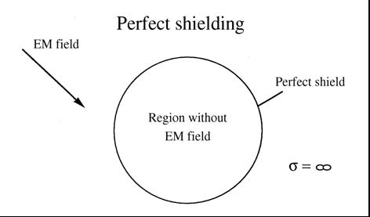
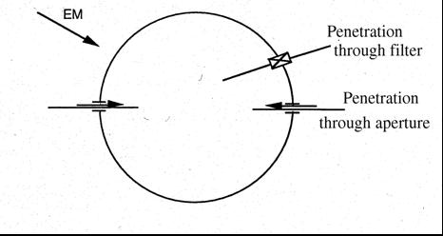
The Conventional View of a Shield
As noted in the illustration, a shield is often thought of as a highly conducting surface surrounding the protected volume
The behavior of a physical shield can be compromised in several different ways
  By a conductor passing through the shield and injecting a signal
  By EM fields leaking through an aperture, seam or other imperfection in the shield, and
  By EM fields diffusing through the shield material to provide an internal response
Usually, this latter subject is what is referred to as “shielding theory”
  Its contribution to the internal response is generally much less than that of the conductors or apertures

Slide 13
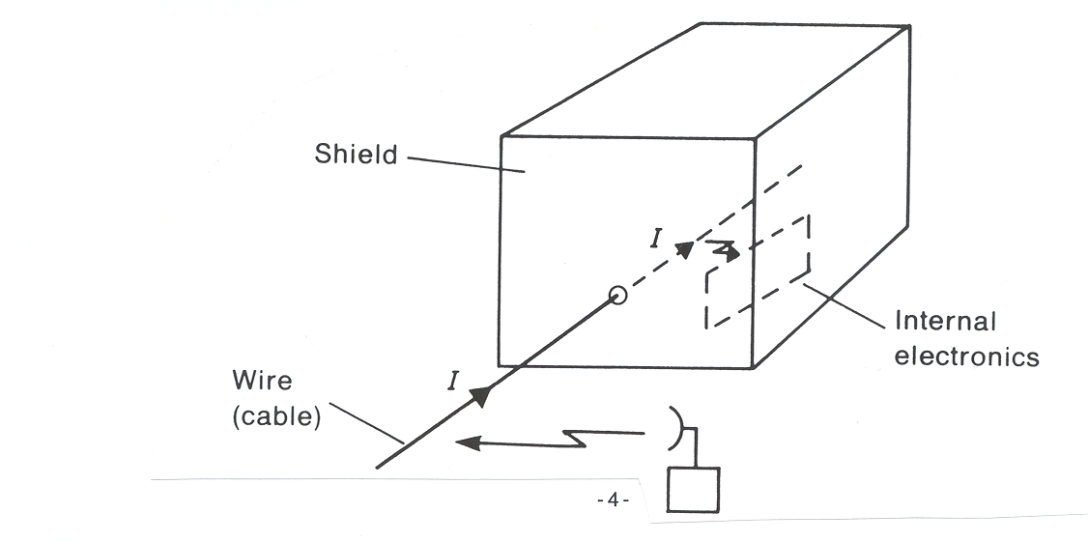
Shielding Effectiveness Degradation
Penetration of an enclosure by a cable allowing direct entry (or exit) of external (internal) fields.

Slide 14
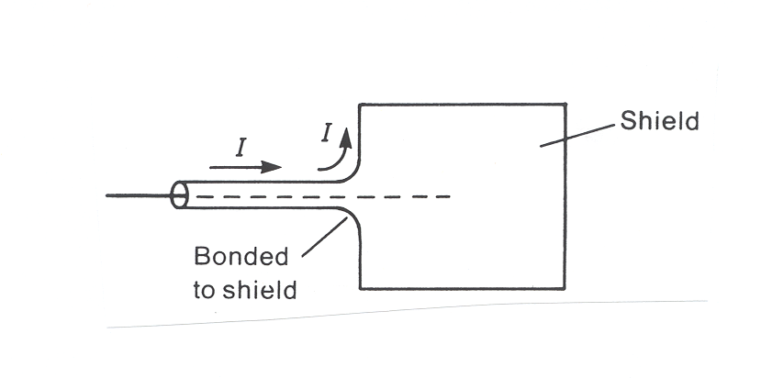
Shielding Effectiveness Degradation
Solution: Filtering of the cable at its entry/exit point or to use shielded cables whose shields are peripherally bonded to the product shield.

Slide 15
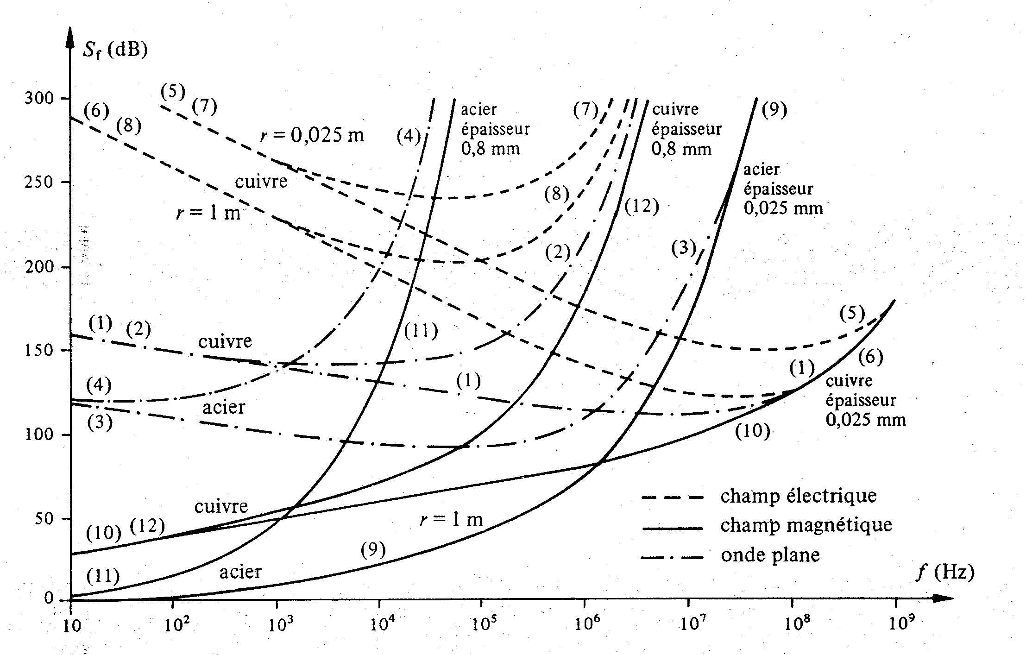
Shielding Materials
Iron
0.8 mm
thick
Copper
0.8 mm
thick
Copper
Iron
0.025 mm
thick
Copper
Copper
0.025 mm
thick
Iron
Copper
Electric field
Magnetic field
Iron
Plane wave
Observation: The magnetic field shielding effectiveness is very low at low frequencies.

Slide 16
Shielding Materials
The shield materials are described by the following parameters:
  Electrical conductivity of the metal σ
  Magnetic permeability μ = μ_{r}μ_{o}
  Frequency f (or ω = 2πf)
  Material thickness Δ, and
  Shape of shield
The term “shielding” can be taken in many different contexts
  It can describe the attenuation of the E-fields, the H-fields, or even the power density in the fields due to the topological barrier
  It can involve static (DC), time harmonic, or transient EM fields

Slide 17
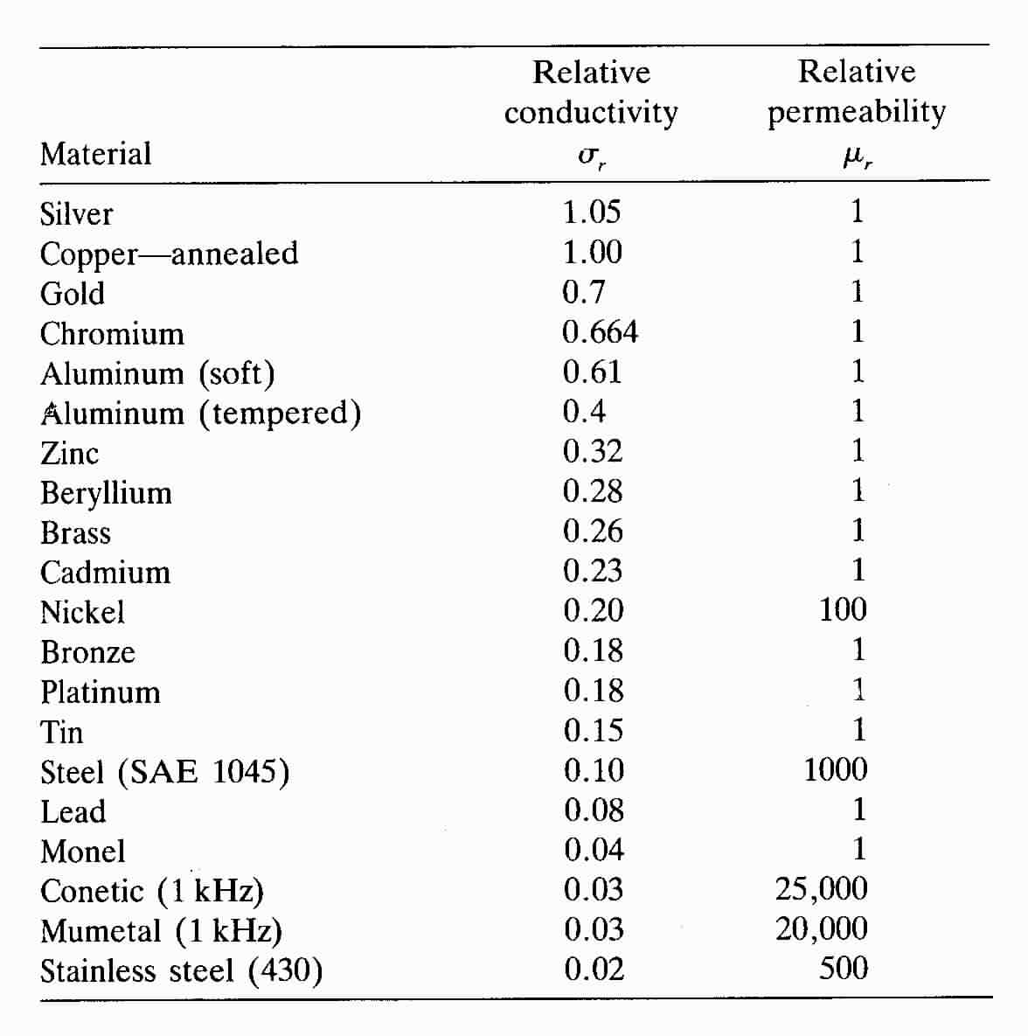
Typical Parameters for Shielding Materials
Relative σ_{r} and μ_{r} of common material
Conductivity is relative to Copper, for which
σ = 5.82 x 10⁷ S/m

Slide 18
Electrostatic Field Shielding
At DC, the E and H-fields decouple
  This results in two separate and independent shielding problems to consider
Electrostatic shielding is easy to accomplish
  By surrounding the region with a good electrical conductor
  Charges move freely and tend to cancel the internal E-field

Slide 19
Shielding Materials
That is the reason for very high SE at low frequencies
Iron
0.8 mm
thick
Copper
0.8 mm
thick
Copper
Iron
0.025 mm
thick
Copper
Copper
0.025 mm
thick
Iron
Copper
Electric field
Magnetic field
Iron
Plane wave

Slide 20
Electrostatic Field Shielding (Cont’d)
The internal electrostatic field is determined by field penetration through apertures or shield imperfections
Thus, for static E-fields, it is not the thickness of the shield that is important, but the “optical coverage” or number of holes that determines the shielding

Slide 21
Electrostatic Field Shielding (Cont’d)
The shielding will be impaired in a certain volume around the hole
  but at a distance larger than several hole diameters, the field weakens by the cube of the distance
At a large distance r from a circular hole with a diameter of d, the E-field magnitude is given as
  E_{o} is the strength of the unperturbed, or incident, normal E-field component.
This equation implies that the field attenuation is more than 40 dB at a distance of only two hole diameters

Slide 22
Question 1
+ q
E_{inside}=?
Zero
Different from zero

Slide 23
Electrostatic Field Shielding (Cont’d)
E_{inside}=0

Slide 24
Question 2
+ q
E_{outside}=?
Zero
Different from zero

Slide 25
Electrostatic Field Shielding (Cont’d)
E_{outside} ≠ 0

Slide 26
Magnetostatic Field Shielding
The electrostatic shielding is achieved by the rearranging electric charges on the surface of the metallic shielding material to reduce the E-field.
Magnetostatic shielding is more difficult to achieve, due to the non–existence of magnetic charges.
Only ferromagnetic materials permit a certain degree of shielding
  This is due to a high relative permeability (μ_{r}).
Ferromagnetic materials are used for magnetostatic shielding
  iron, nickel, cobalt, rare earth elements (gadolinium and terbium) and oxides and alloys of these elements.

Slide 27
Shielding Materials
Iron
0.8 mm
thick
Copper
0.8 mm
thick
Copper
Iron
0.025 mm
thick
Copper
Copper
0.025 mm
thick
Iron
Copper
Electric field
Magnetic field
Iron
Plane wave
That is the reason for very low SE at low frequencies

Slide 28
Magnetostatic Field Shielding (Cont’d)
Illustration of the static magnetic field in the vicinity of a thin, permeable spherical shell
The field is not affected by the electrical conductivity σ, but rather, it depends on the magnetic permeability μ=μ_{r}μ_{o}
  A shield with a high value of μ_{r} tends
  to exclude the H-field better
  If μ_{r} = 1, the field does not sense
  the shield, and the internal
  field equals the external
  field - no shielding occurs

Slide 29
Magnetostatic Field Shielding (Cont’d)
To calculate the internal field, we can use a scalar magnetic potential φ satisfying Laplace’s equation
And the H-field may be calculated as
Outside the sphere, the potential has the form
  where r and θ are the spherical coordinates, and H^{inc} is the external incident magnetic field
See: Van Bladel, J., Electromagnetic Fields, McGraw Hill, New York, 1964.

Slide 30
Magnetostatic Field Shielding (Cont’d)
Within the spherical shell material (for a ≥ r ≥ b) the potential is of the form
And within the center hollow region of the shell, it is
The unknown coefficients A, B, C and D must be determined from the boundary conditions that both φ and (μ δφ/δr) be continuous functions at r = a and r = b.
The resulting internal H-field then is expressed as

Slide 31
Magnetostatic Field Shielding (Cont’d)
Notice that if the shell material is non-magnetic, μ_{r} = 1
  This result in no shielding: H^{in} = H^{inc}.
For a thin shell of thickness Δ = (b - a) made of a highly magnetic material (μ_{r} >> 1,) the internal field is approximately

Slide 32
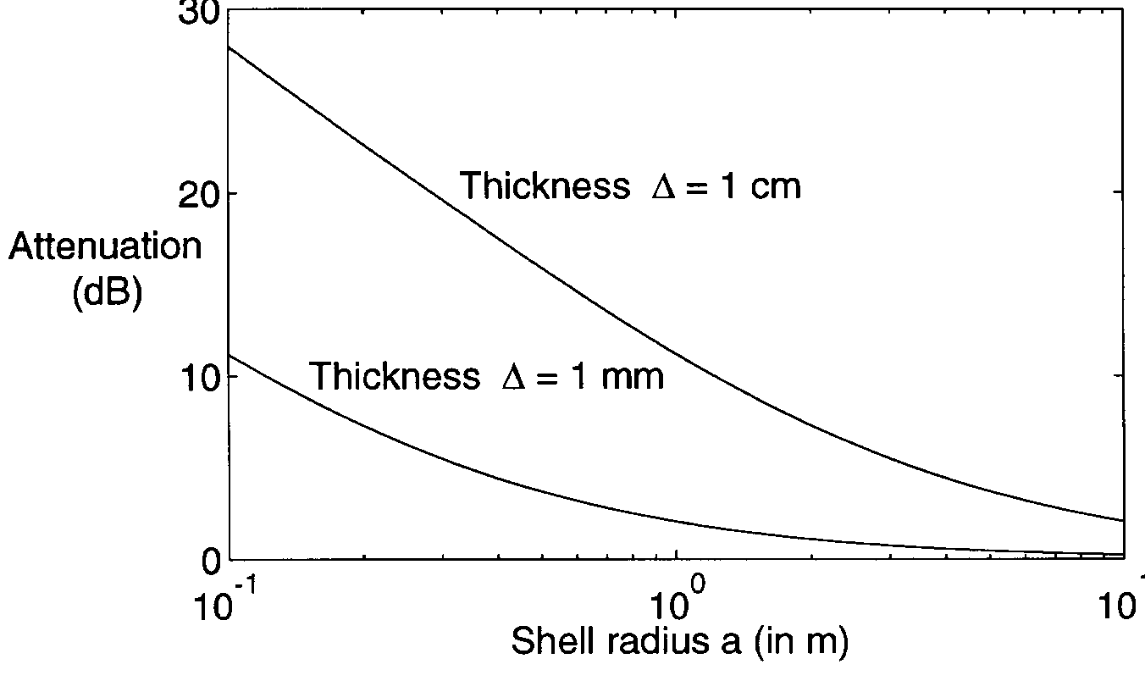
Magnetostatic Field Shielding (Cont’d)
Illustration of the static magnetic field attenuation factor of a thin spherical shell of iron with μ_{r}= 400.

Slide 33
Low Frequency Magnetic Field Shielding
SE Degradation of Ferromagnetic Materials
The permeability of ferromagnetic materials decreases with frequency
In general, the ferromagnetic material manufacturers specify the relative permeability of materials at low frequency (< 1 kHz)!

Slide 34
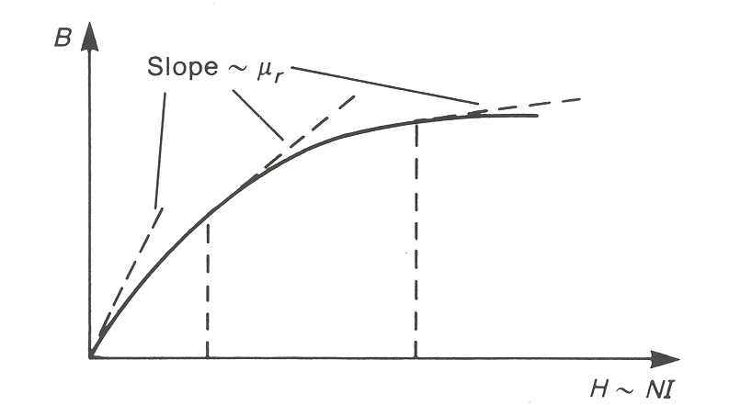
Low Frequency Magnetic Field Shielding
SE Degradation of Ferromagnetic Materials
The permeability of ferromagnetic materials decrease with the intensity of the magnetic field.

Slide 35
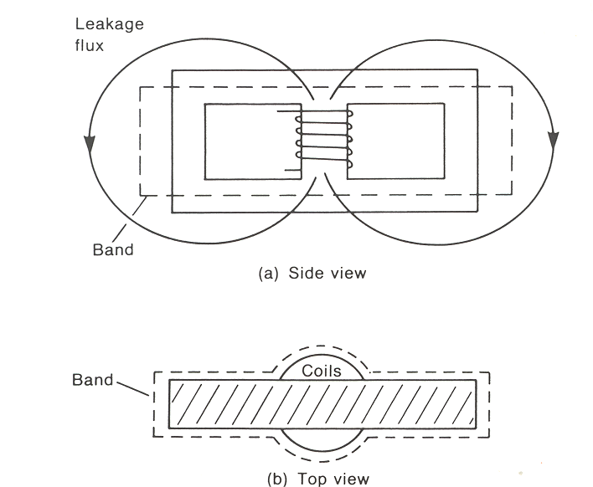
Low Frequency Magnetic Field Shielding
Use of ‘Shorted Turn Effect’ in the Reduction of H-Field
A common application of the ‘shorted turn’ effect in the reduction of magnetic fields is with transformers of switching power supplies. A conductive ‘turn’ consisting of contiguous strip of copper tapen is wrapped around the transformer.

Slide 36
Low Frequency Magnetic Field Shielding
Use of ‘Shorted Turn Effect’ in the Reduction of H-Field
The objective is to reduce the radiated magnetic field of the leakage flux of the transformer. It is important to place the loop such that the surface bounded by the loop is as perpendicular as possible to the flux that is intended to cancel.

Slide 37
Shielding Effectiveness of a Metallic Barrier
Shielding effectiveness of the barrier for the E-field:
For the H-field:
For a plane wave, we have

Slide 38
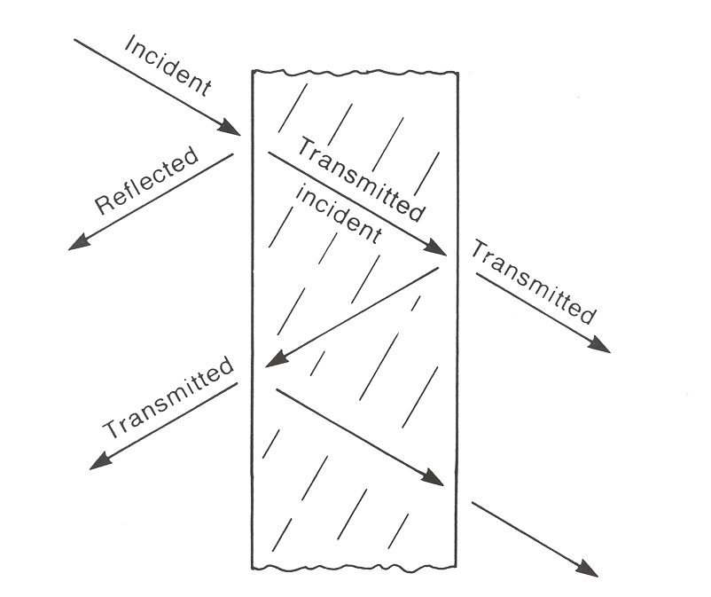
Shielding Effectiveness of a Metallic Barrier
Shielding effectiveness can be decomposed into three terms:
R_{dB}: Reflection losses (reflection
at interfaces of the barrier)
A_{dB}: Absorption losses (absorption through the metallic thickness)
M_{dB}: Multiple reflection and transmission. This term is negative and, in general, will reduce the shielding effectiveness.

Slide 39
Shielding Effectiveness of a Metallic Barrier
Solutions for Plane Wave Excitation
Assuming that the barrier is constructed of a good conductor and the barrier thickness t is much greater than the skin depth at the frequency of the incident wave, t>>δ, the following expressions can be derived

Slide 40
Shielding Effectiveness of a Metallic Barrier
Solutions for Plane Wave Excitation
Iron
0.8 mm
thick
Copper
0.8 mm
thick
Copper
Iron
0.025 mm
thick
Copper
Copper
0.025 mm
thick
Iron
Copper
Electric field
Magnetic field
Iron
Plane wave

Slide 41
Example: Field Penetration in a Shielded Enclosure with an Aperture (Door)

Slide 42
Example: Field Penetration in a Shielded Enclosure with an Aperture (Door)
Incident E-Field

Slide 43
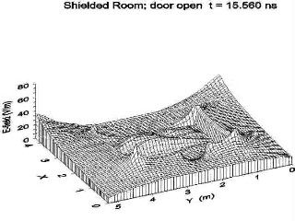
Example: Field Penetration in a Shielded Enclosure with an Aperture (Door)
Electric Field Distribution
(Obtained using FDTD method, Courtesy of Dr. F.M. Tesche)
t=15.56 ns

Slide 44
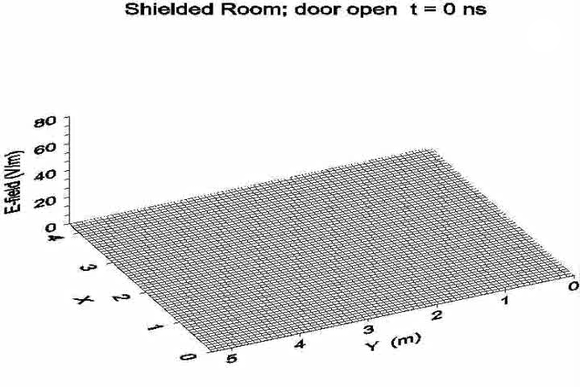
Example: Field Penetration in a Shielded Enclosure with an Aperture (Door)

Slide 45
Example: Field Penetration in a Shielded Enclosure with a Conductor (Door Closed)

Slide 46

Example: Field Penetration in a Shielded Enclosure with a Conductor (Door Closed)

Slide 47
Cable Penetrations
out
in
E
x
t
é
r
i
e
u
r
I
n
t
é
r
i
e
u
r
external
ground
T
e
r
r
e
e
x
t
e
r
n
e
T
e
r
r
e
i
n
t
e
r
n
e
internal
ground
(
a
)
C
o
n
d
u
c
t
e
u
r
s
d
e
m
i
s
e
à
l
a
t
e
r
r
e
correct
compromise
bad

Slide 48
Cable Penetrations
out
in
E
x
t
é
r
i
e
u
r
I
n
t
é
r
i
e
u
r
T
u
b
e
G
u
i
d
e
d
'
o
n
d
e
Tube
Waveguide
Cable Shield
B
l
i
n
d
a
g
e
d
e
c
â
b
l
e
(
b
)
C
o
n
d
u
c
t
e
u
r
q
u
e
l
'
o
n
m
e
t
à
l
a
t
e
r
r
e
correct
compromise
bad

Slide 49
Cable Penetrations
out
in
E
x
t
é
r
i
e
u
r
I
n
t
é
r
i
e
u
r
Simple
Conductor
C
o
n
d
u
c
t
e
u
r
i
s
o
l
é
Surge arrester
Filter
P
a
r
a
s
u
r
t
e
n
s
i
o
n
o
u
f
i
l
t
r
e
(
c
)
C
o
n
d
u
c
t
e
u
r
s
i
s
o
l
é
s
correct
compromise
bad

Slide 50
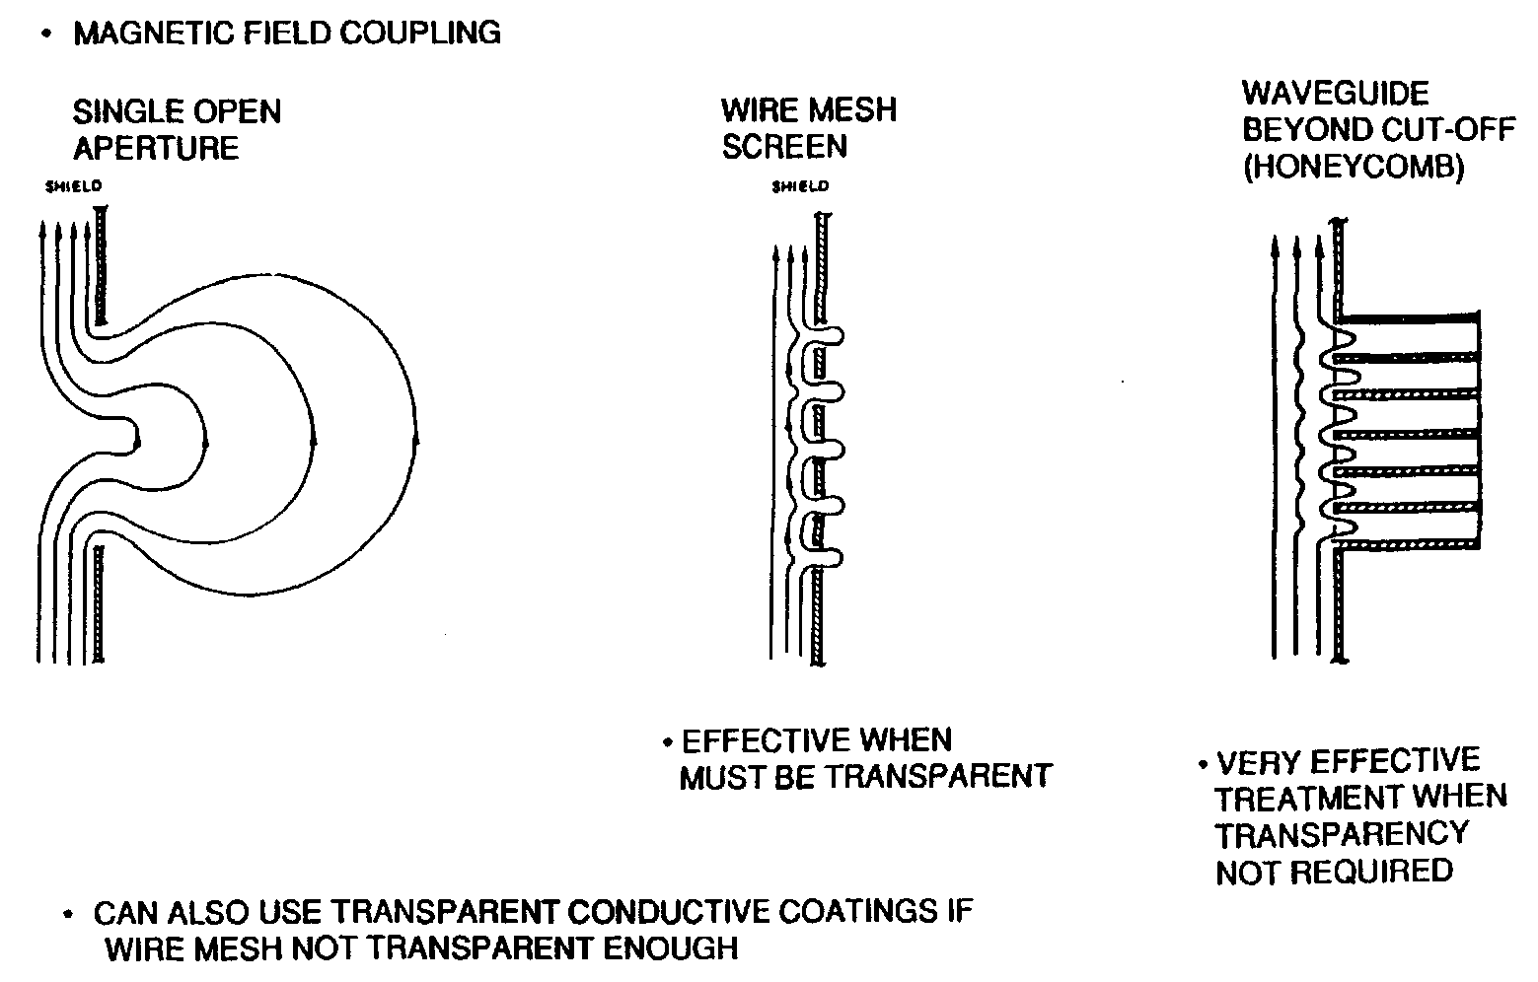
Apertures

Slide 51
Apertures
External
H-Field
Shield
C
h
a
m
p
B
l
i
n
d
a
g
e
m
a
g
n
é
t
i
q
u
e
Conductor
e
x
t
e
r
n
e
C
o
n
d
u
c
t
e
u
r
i
n
t
e
r
n
e
Shield
B
l
i
n
d
a
g
e
c
a
b
l
e
Penetrating Field through Aperture
Conductor
C
h
a
m
p
C
h
a
m
p
q
u
i
i
n
t
e
r
n
e
External
E-Field
é
l
e
c
t
r
i
q
u
e
p
é
n
è
t
r
e
à
t
r
a
v
e
r
s
e
x
t
e
r
n
e
l
'
o
u
v
e
r
t
u
r
e
Penetrating Field through Aperture
C
h
a
m
p
q
u
i
p
é
n
è
t
r
e
à
t
r
a
v
e
r
s
l
'
o
u
v
e
r
t
u
r
e
(
a
)
c
h
a
m
p
é
l
e
c
t
r
i
q
u
e
(
b
)
C
h
a
m
p
m
a
g
n
é
t
i
q
u
e

Slide 52
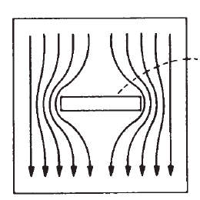
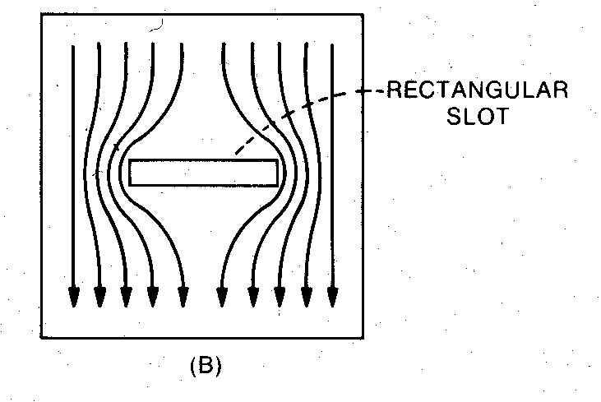
Effect of Slots
_{Induced Currents}
_{Slot with length l}
_{Solid Shield}

Slide 53
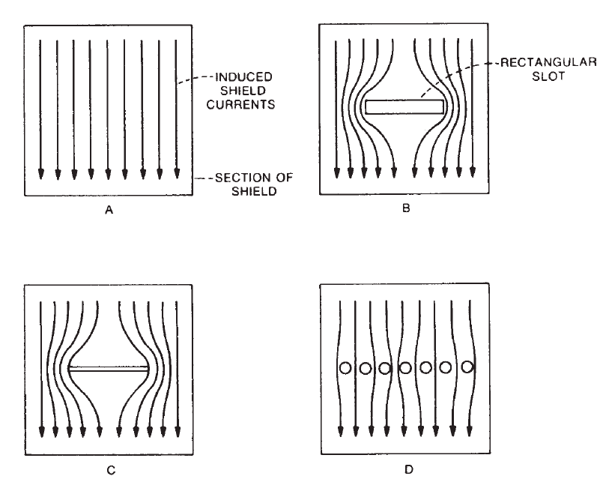
Effect of Slots

Slide 54
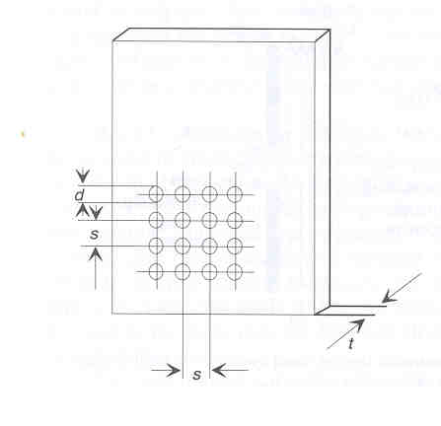
Multiple Apertures
More than one aperture will reduce the shielding effectiveness of an enclosure. The amount of reduction depends on
The number of apertures
The frequency
The spacing between apertures
For a linear array of closely spaced apertures, the reduction in SE if proportional to the square root of the number of apertures. Thereforem the SE for multiple apertures is

Slide 55
Openings in Shielded Enclosures
Openings in shielded enclosures (or holes in thick barriers) can also be protected by using the ‘waveguide above cutoff’ principle. The size of the holes should be selected such that it remains below the wavelength corresponding to the lowest cutoff frequency (at the highest interference frequency).
Fields transmitted through a waveguide below cutoff are attenuated approximatively exponentially with distance along the guide. The attenuation constant for a waveguide below cutoff frequency is given by:
with f_{c} >> f

Slide 56
Openings in Shielded Enclosures
The cutoff frequency is a function of the cross-sectional geometry of the waveguide.
A square waveguide with side dimensions d has a cutoff frequency for the propagation of higher-order modes TEmn (transverse electric) and TMmn (transverse magnetic) given by

Slide 57
Openings in Shielded Enclosures
The lowest-order propagating mode is the TE10 mode, with the cutoff frequency
corresponding to

Slide 58
Openings in Shielded Enclosures
The reflection loss is given by
The total shielding effectiveness is given by

Slide 59
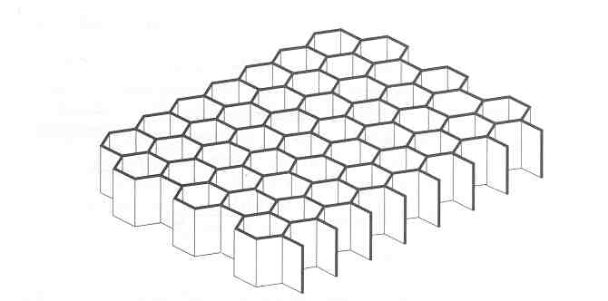
Honeycomb Air Vents
Panels made of metallic hexagonal honeycomb maetrials are used to maintain shielding integrity.
Air vent panels take advantage of the waveguide principles as they apply to the individual honeycomb cell.
Total shielding effectiveness for n number of rectangular cells is given by
n being the total number of cells and f << f_{c}

